Slide 1
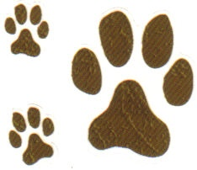
PAWSWARE
Data warehouse

Slide 2
Overview
PAWSWARE is a data warehouse registry of pet adoption data.
The purpose of the DWH and some use cases:
Have a central repository of data of pets that up for adoption
Goal of the DWH is to gain knowledge from the data
Know where pets for adoption come from: what is the pet situation
Make pet adoption data more accessible
Develop a recommendation system
The background for the project is from a Kaggle published dataset.
The data consists of structured data (standard format), image files, and JSON files (output from Google API’s).

Slide 3
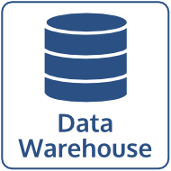
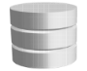

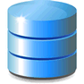



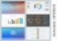
Design Approach
Pet Adoption Data Warehouse
Structured and unstructured data:
-pet adoption demographics
-image sentiment API in json format
In native formats
Across a cluster of computing nodes on commodity server hardware
Upload all data into Data Lake
Web Application/User Interface

Slide 4
DESIGN COMPARISON
 | Advantage | Disadvantage
Key-value | -Good for storing path to image files | -Only store a unique key value pair -Can query DB on value
Column | -Handles growing data and extensible schema | -usually used for batch MapReduce jobs -no SQL for real-time data access
Graph | -good for the analysis of animal adoption trends (ex. Adoption occurs in which places) | -Not a good fit for BI analytics using aggregations (list states with pets cost>100 age> and age <4). -No versioning on datasets.
Document | -Would be good for the real time analytics (recommendation system) | -Possible to do a full table scan on the analytics
Hive | -DWH capabilities -SQL batch query -stores unstructured data | -No RDBMS capabilities (schema applied on read)

Slide 5
WHY Choose MYSQL (RDBMS vs NOSQl)
More connectivity to enterprise tools
MySQL engine : good ACID properties (Consistency and Availability)
Designed for web-applications (build to read from DWH)
MySQL is implemented on distributed nodes: sharding – faster computing
Easier database administration and maintenance (more information available)
Lower cost / TCO

Slide 6
Data Transfer REQUIREMENTS
Source Files
Conversion
Custom delimited files containing all pet adoption related data (identified in logical model)
JSON files: Google vision API and Google natural language API
Images files: pictures of pet
Fields must be mapped to a valid values for the target variable
Valid values are stored in the a vocabulary table (why use lookup table: easy to add values, add is more portable between databases)

Slide 7
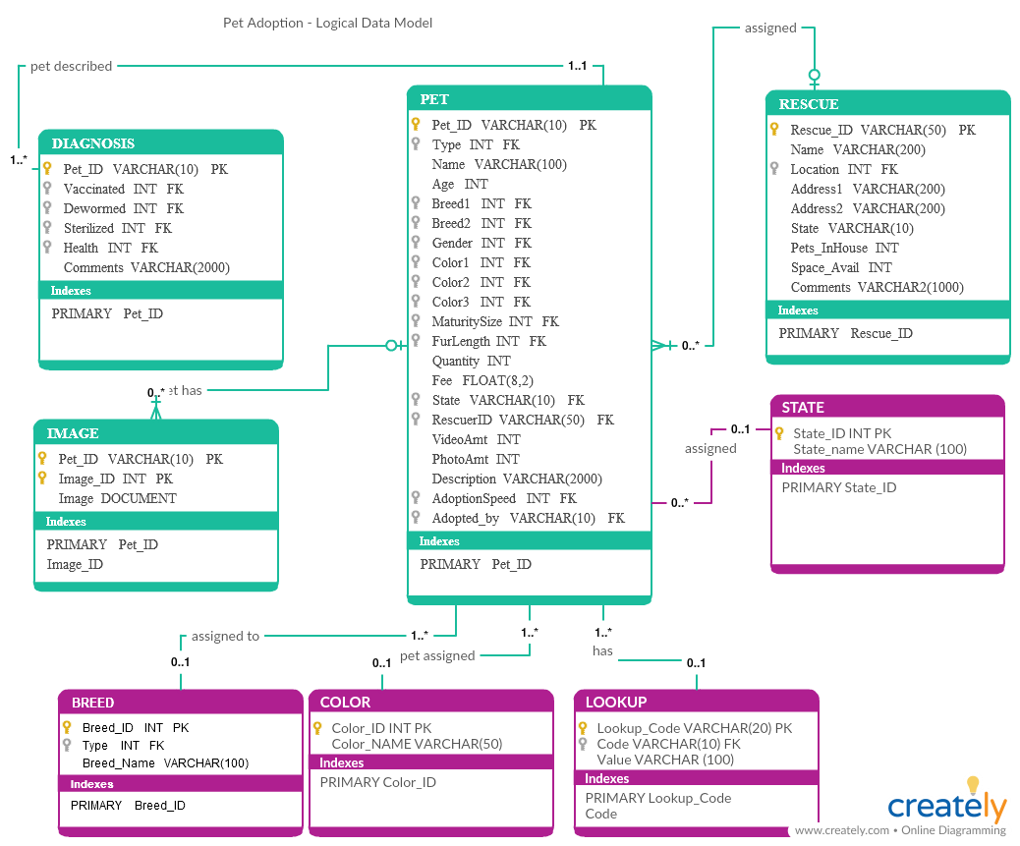
DATA MODEL

Slide 8
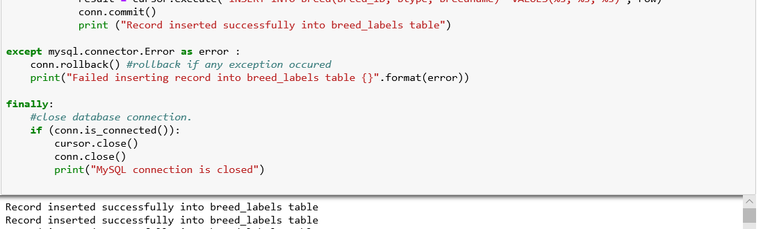
Data Load into database

Slide 9
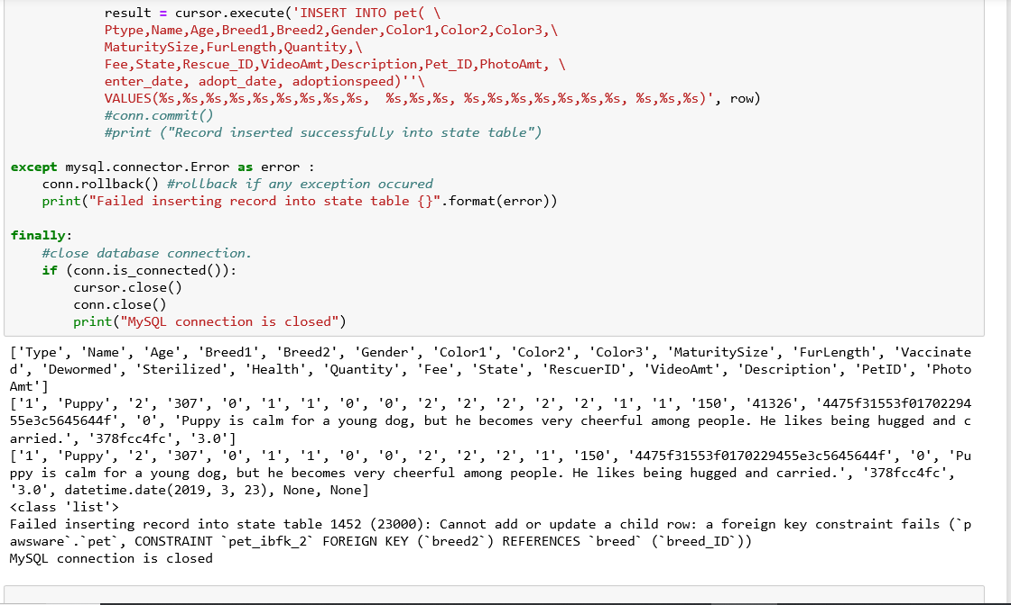
Data Load into database (cont’d)

Slide 10
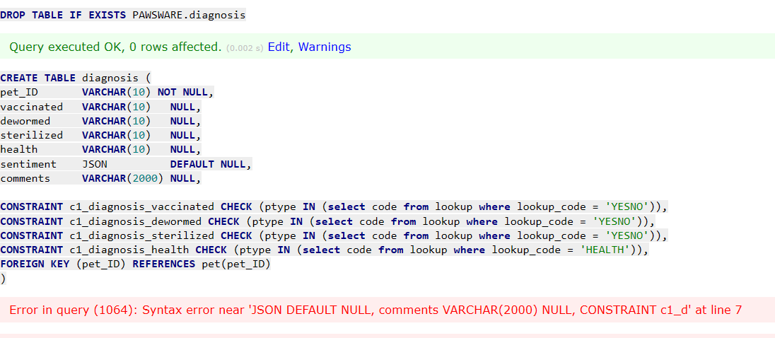
CHALLENGES
DDL: Some tables could not be created as designed (JSON data type)
Python load program: source data required some cleaning/transformations

